Slide 1

ONE CAN
1 MILLION WATTS
PRODUCT CATALOGUE 2026
EU-MADE ENERGY DRINK • BUILT FOR GLOBAL MARKETS
Notes:
Source: Mega Watt official website, https://www.mega-watt.eu/ (accessed 12 September 2026). Cover visual supplied by Mega Watt Europe GmbH.

Slide 2

THE BRAND
Energy with a point of view
Mega Watt is a German energy drink brand created for consumers who want bold taste, sharp identity and unmistakable shelf presence.
1M
A memorable brand idea
One can represents one million watts of energy, confidence and possibility.
EU
European production
Consistent manufacturing, quality control and export-ready documentation.
B2B
Built for distribution
Ready creative assets, practical logistics and a dedicated international team from Germany to the World .
MEGA-WATT.EU • 02
Notes:
Source: Mega Watt official website, https://www.mega-watt.eu/ (accessed 12 September 2026).

Slide 3
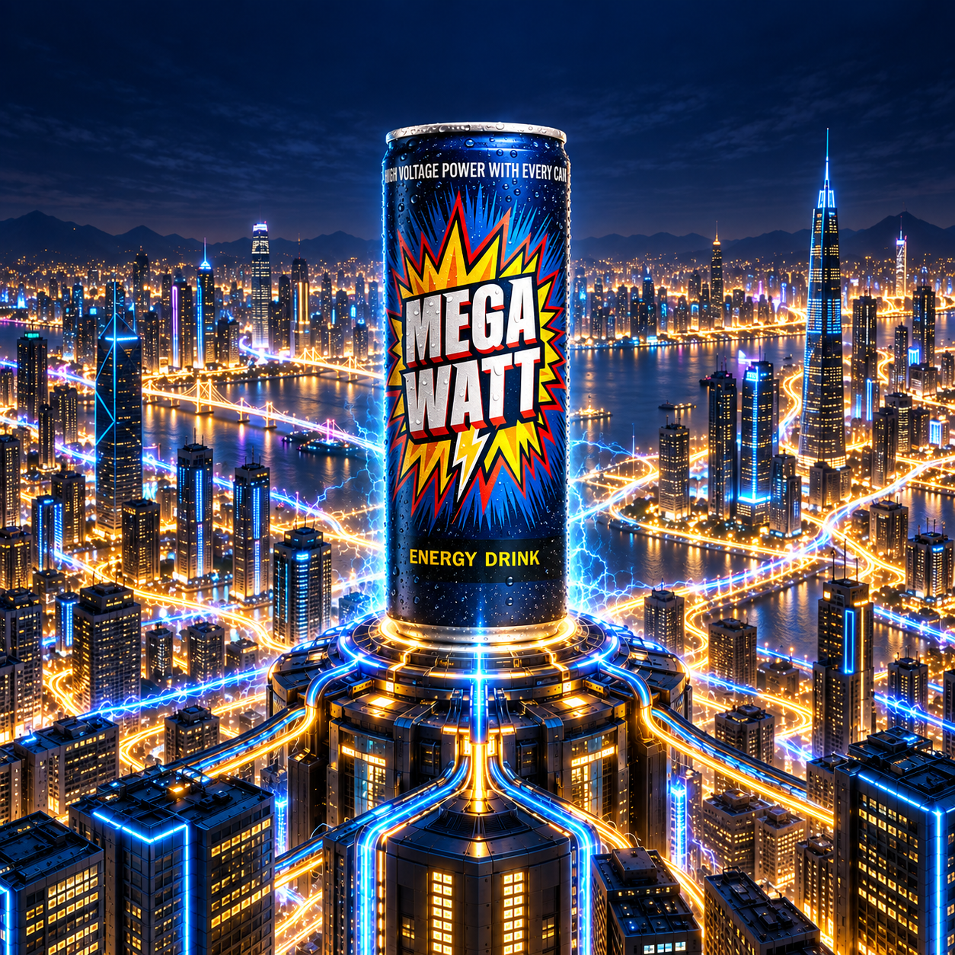
CLASSIC
THE ORIGINAL CHARGE
Signature energy profile
A crisp, refreshing classic built for broad appeal and high repeat purchase.
250 ml slim can
32 mg/100 ml caffeine
B3 • B5 • B6 • B12
MEGA-WATT.EU • 03
Notes:
Source: Mega Watt official website, https://www.mega-watt.eu/ (accessed 12 September 2026). Product visual supplied by Mega Watt Europe GmbH. Specifications may vary by market; final data according to technical sheet and label.

Slide 4
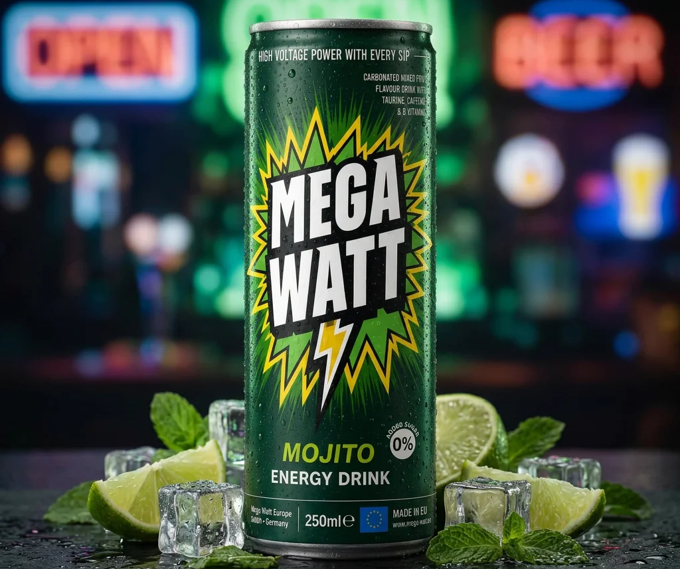
MOJITO
CITRUS MINT SNAP
Fresh citrus character
A lively mojito-inspired profile with a cool, refreshing finish.
250 ml slim can
32 mg/100 ml caffeine
B3 • B5 • B6 • B12
MEGA-WATT.EU • 04
Notes:
Source: Mega Watt official website, https://www.mega-watt.eu/ (accessed 12 September 2026). Product visual supplied by Mega Watt Europe GmbH. Specifications may vary by market; final data according to technical sheet and label.

Slide 5
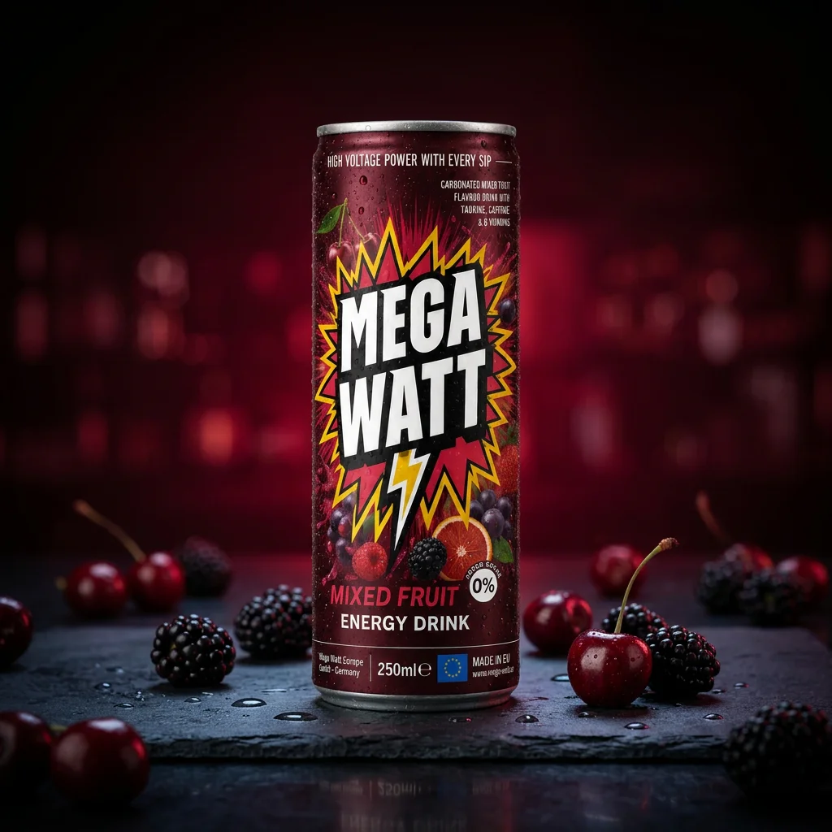
MIXED FRUIT
DARK FRUIT POWER
Layered fruit character
A bold, vibrant blend with a dramatic red identity and energetic finish.
250 ml slim can
32 mg/100 ml caffeine
B3 • B5 • B6 • B12
MEGA-WATT.EU • 05
Notes:
Source: Mega Watt official website, https://www.mega-watt.eu/ (accessed 12 September 2026). Product visual supplied by Mega Watt Europe GmbH. Specifications may vary by market; final data according to technical sheet and label.

Slide 6
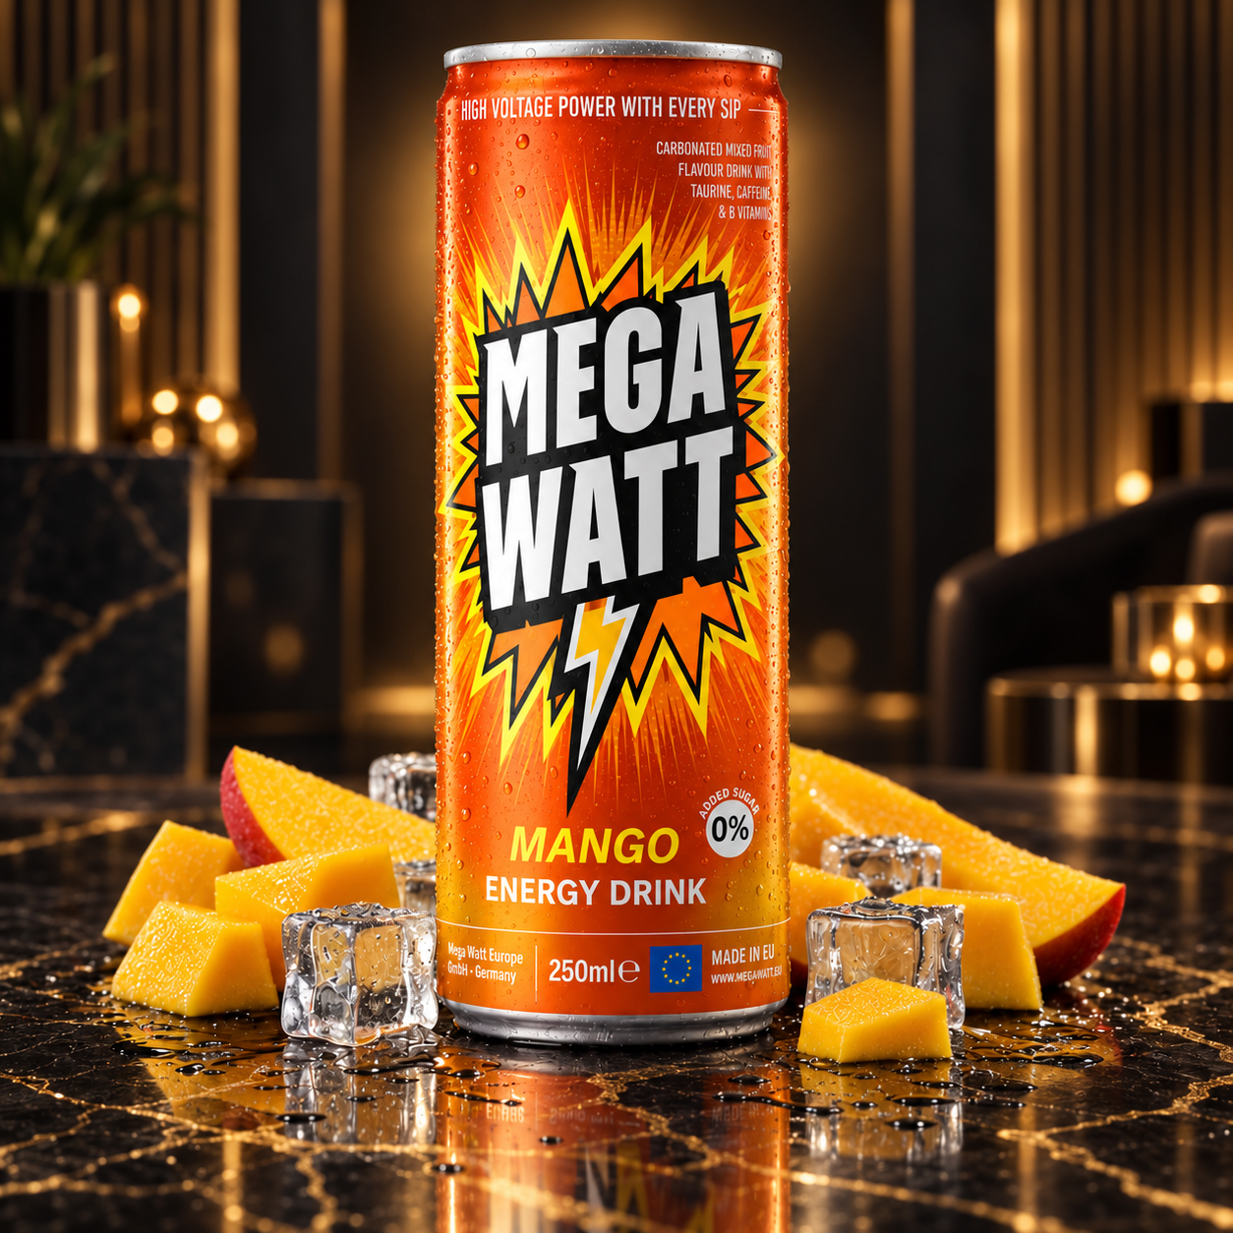
MANGO
TROPICAL VOLTAGE
Smooth tropical profile
A sunny, approachable flavor with strong visual appeal for warm markets.
250 ml slim can
32 mg/100 ml caffeine
B3 • B5 • B6 • B12
MEGA-WATT.EU • 06
Notes:
Source: Mega Watt official website, https://www.mega-watt.eu/ (accessed 12 September 2026). Product visual supplied by Mega Watt Europe GmbH. Specifications may vary by market; final data according to technical sheet and label.

Slide 7
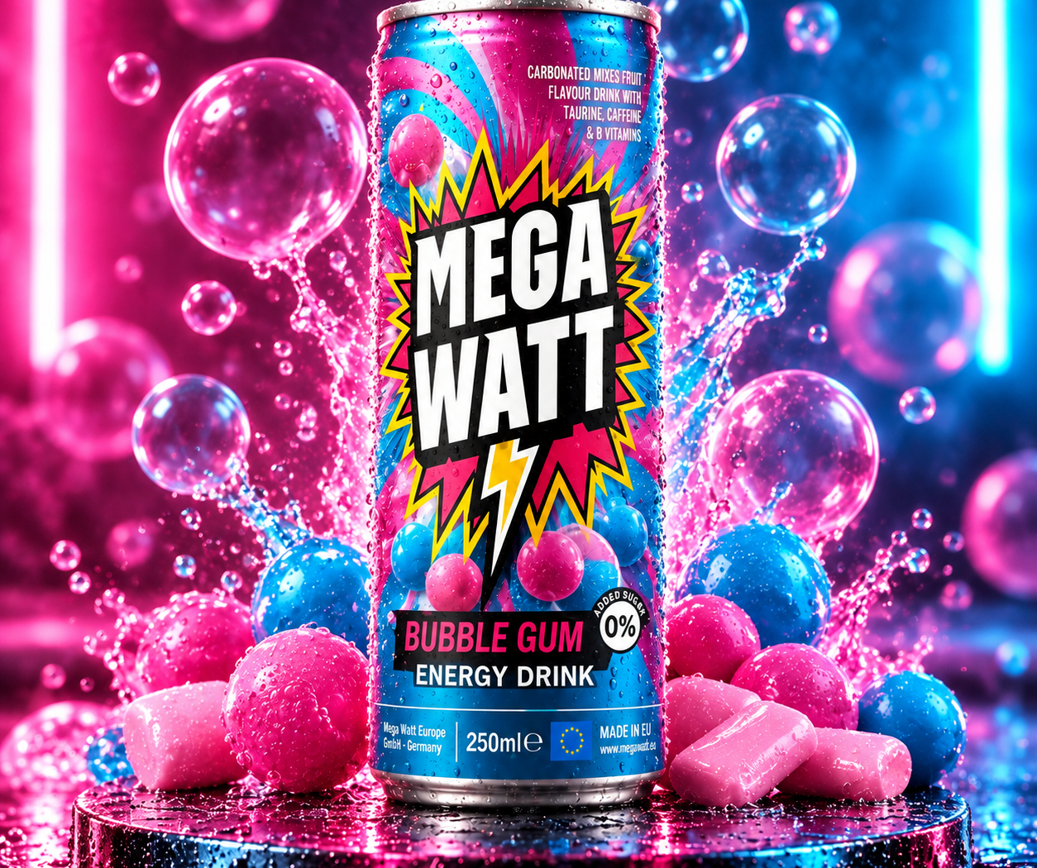
BUBBLE GUM
PLAYFUL POWER
Unexpected and memorable
A colorful flavor concept created for discovery, social sharing and younger adult audiences.
250 ml slim can
32 mg/100 ml caffeine
B3 • B5 • B6 • B12
MEGA-WATT.EU • 07
Notes:
Source: Mega Watt official website, https://www.mega-watt.eu/ (accessed 12 September 2026). Product visual supplied by Mega Watt Europe GmbH. Specifications may vary by market; final data according to technical sheet and label.

Slide 8
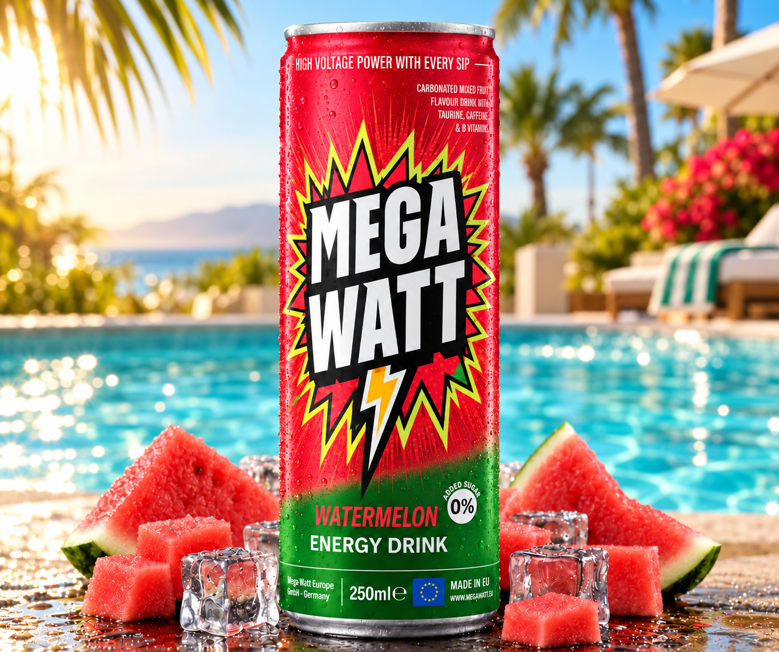
WATERMELON
JUICY CURRENT
Fresh and vibrant
A playful watermelon profile with a powerful red-and-green shelf signature.
250 ml slim can
32 mg/100 ml caffeine
B3 • B5 • B6 • B12
MEGA-WATT.EU • 08
Notes:
Source: Mega Watt official website, https://www.mega-watt.eu/ (accessed 12 September 2026). Product visual supplied by Mega Watt Europe GmbH. Specifications may vary by market; final data according to technical sheet and label.

Slide 9
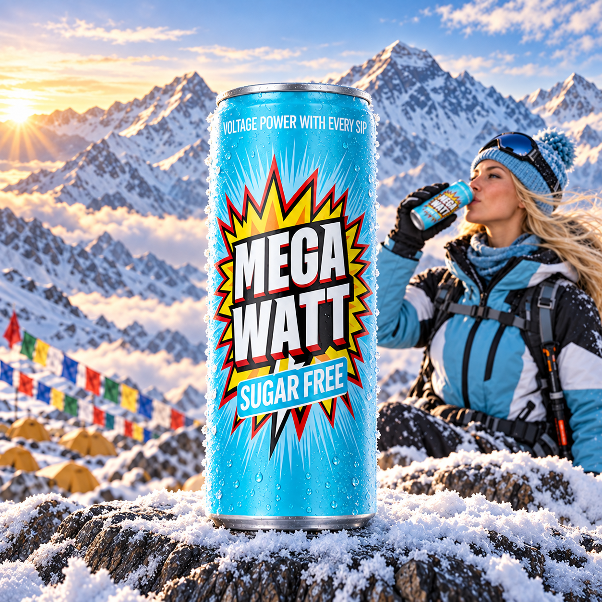
SUGAR FREE
CLEAN KICK
Zero-sugar option
Full Mega Watt attitude for consumers choosing a sugar-free energy drink.
250 ml slim can
32 mg/100 ml caffeine
B3 • B5 • B6 • B12
MEGA-WATT.EU • 09
Notes:
Source: Mega Watt official website, https://www.mega-watt.eu/ (accessed 12 September 2026). Product visual supplied by Mega Watt Europe GmbH. Specifications may vary by market; final data according to technical sheet and label.

Slide 10
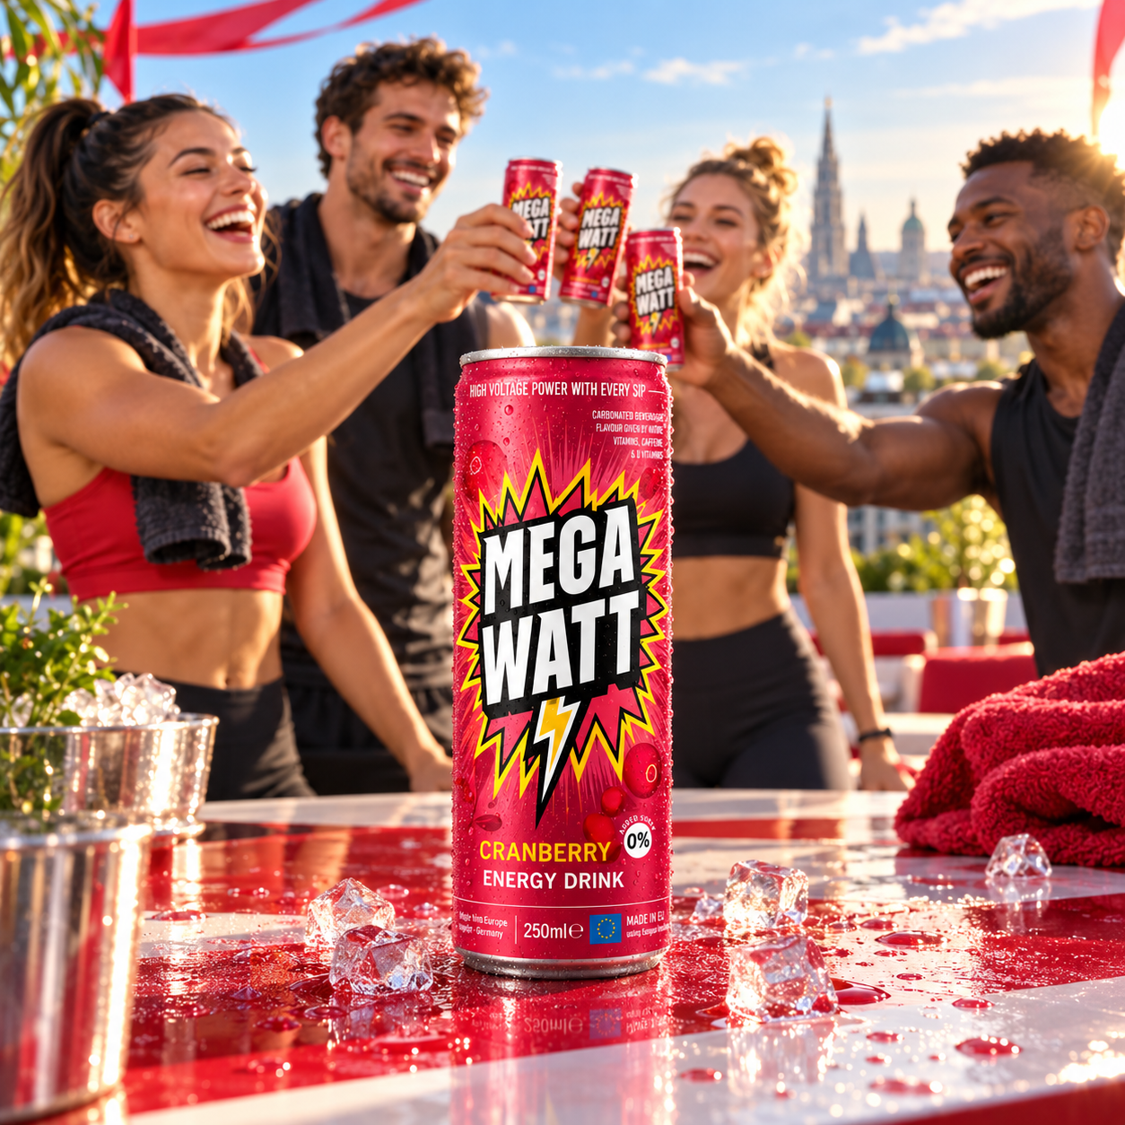
CRANBERRY
BOLD BERRY BITE
Bright berry profile
A distinctive cranberry expression designed to stand out in chilled displays.
250 ml slim can
32 mg/100 ml caffeine
B3 • B5 • B6 • B12
MEGA-WATT.EU • 10
Notes:
Source: Mega Watt official website, https://www.mega-watt.eu/ (accessed 12 September 2026). Product visual supplied by Mega Watt Europe GmbH. Specifications may vary by market; final data according to technical sheet and label.

Slide 11
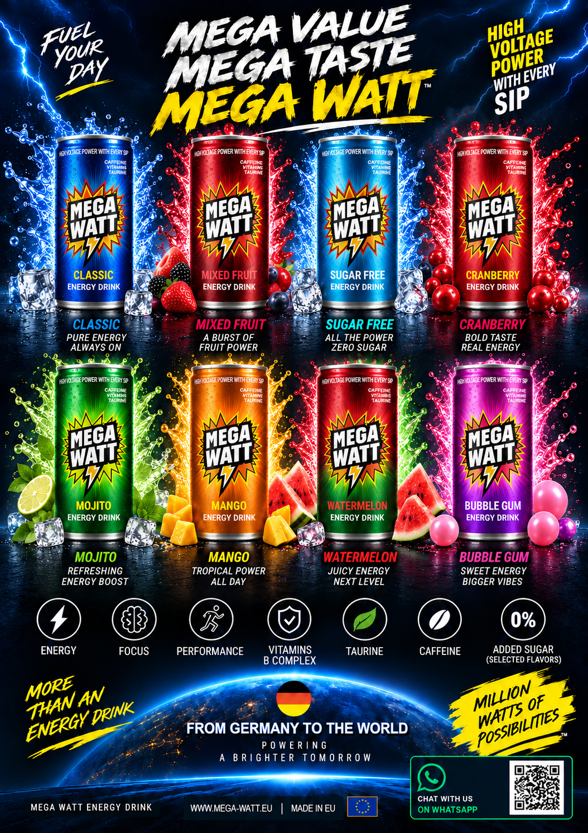
Notes:
Source: Mega Watt official website, https://www.mega-watt.eu/ (accessed 12 September 2026). Product visuals supplied by Mega Watt Europe GmbH.

Slide 12
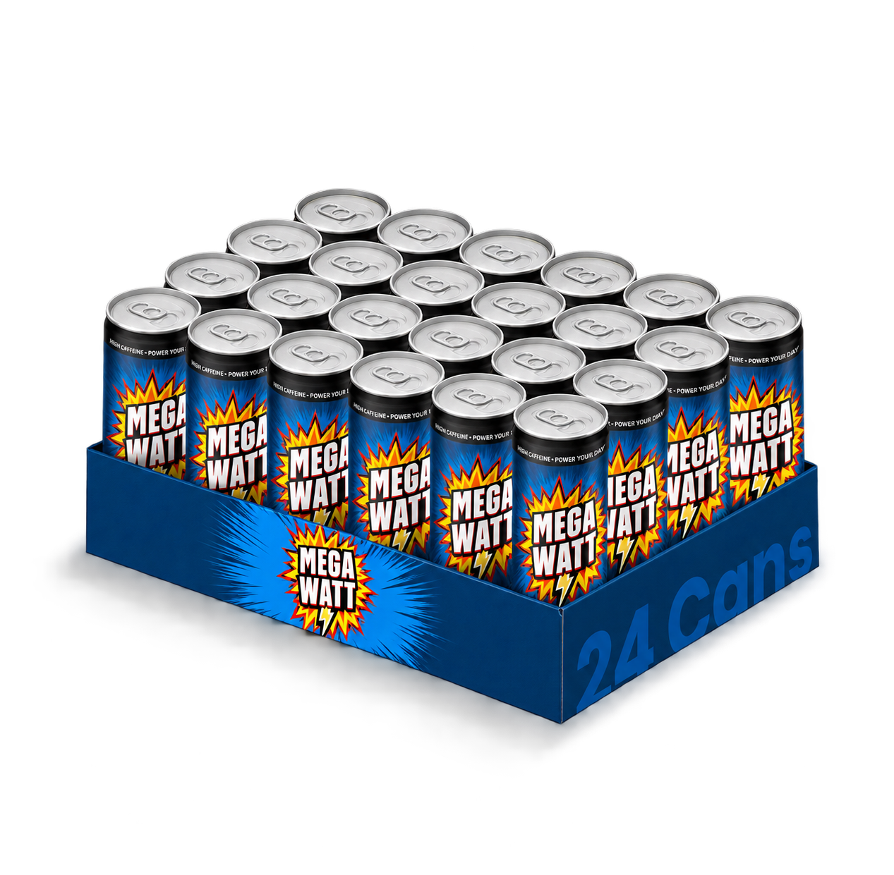
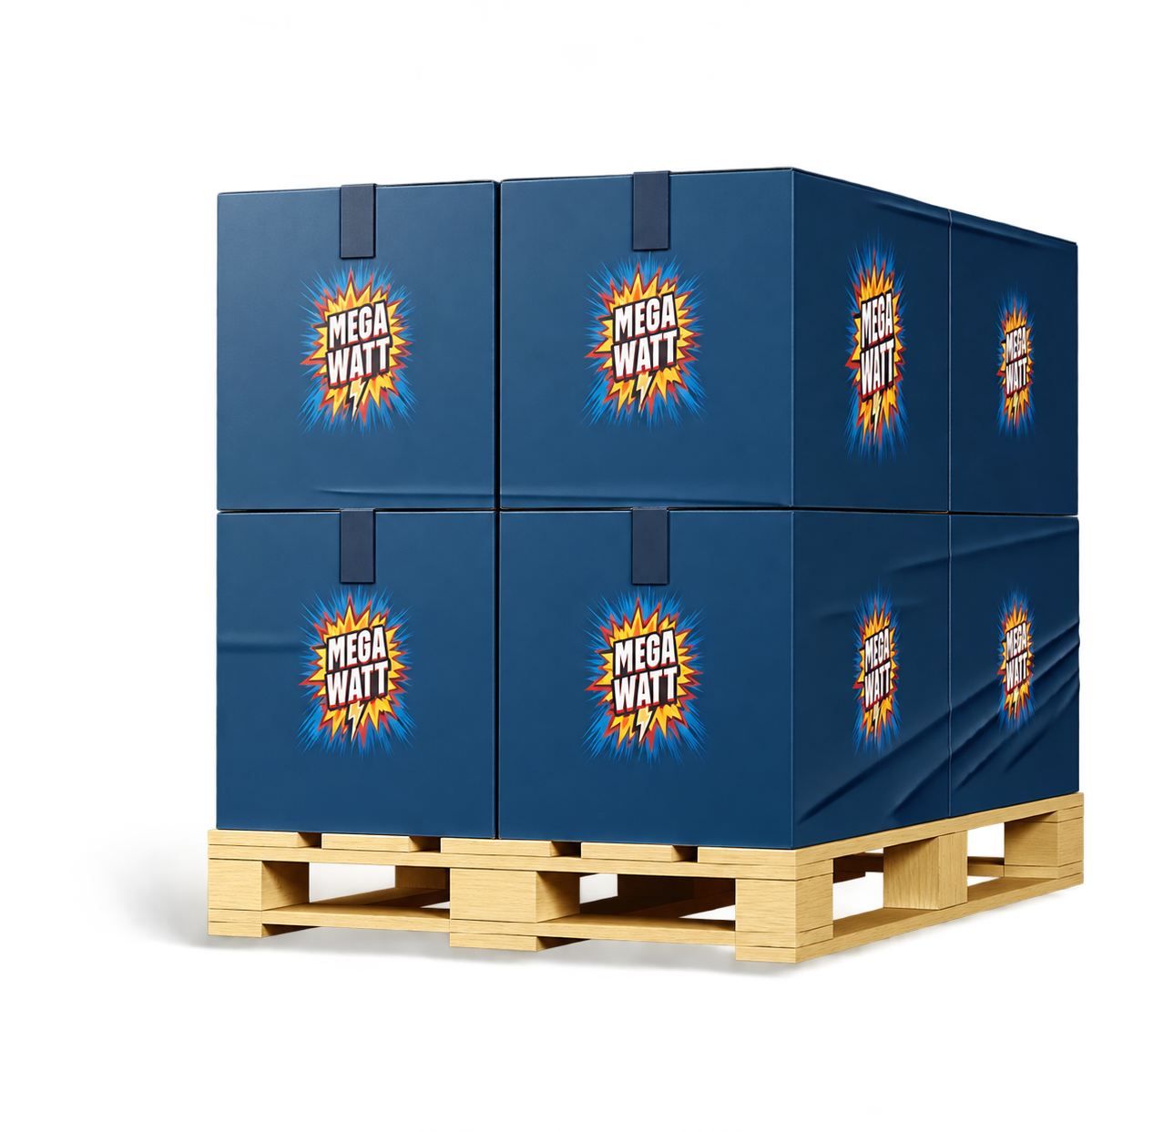
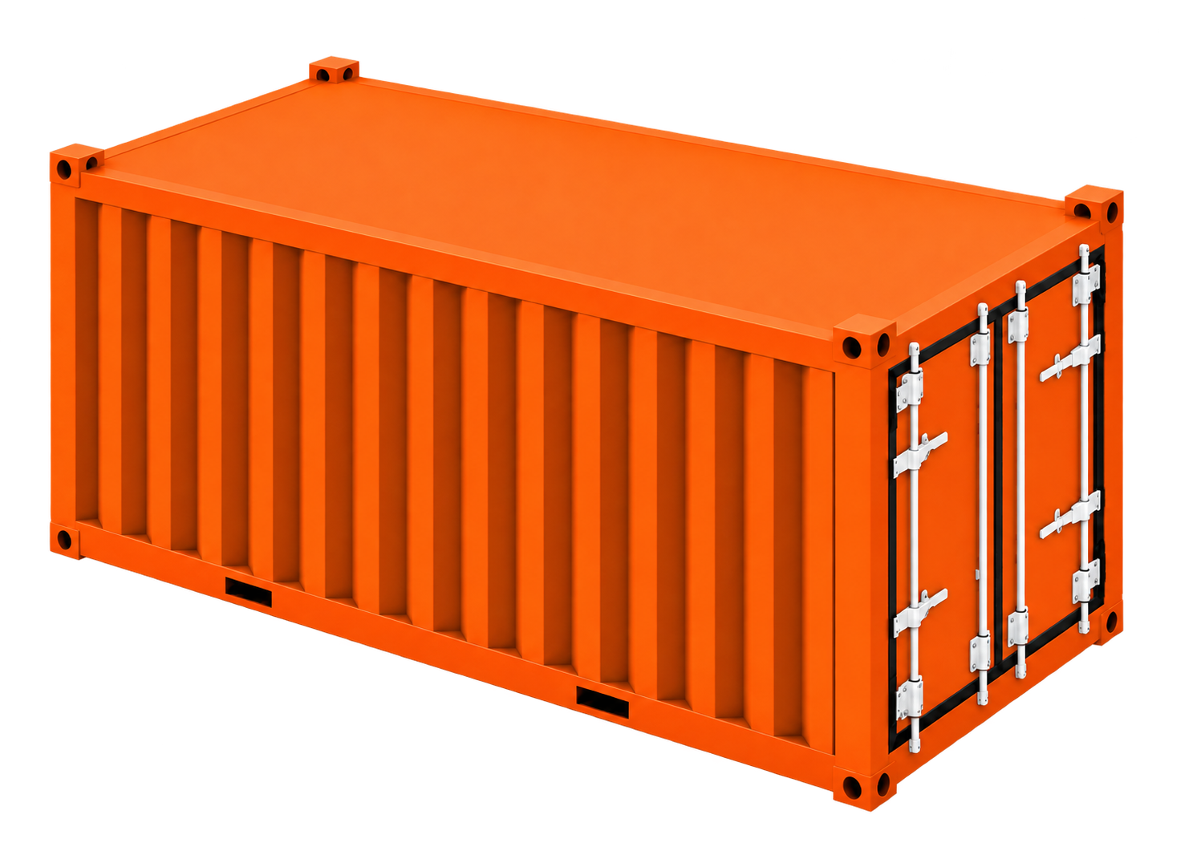
Logistics Data
1 Tray
24 Cans
1 Pallet
144 Trays/3456 Cans
1 40 Feet Container
info@mega-watt.eu
+49 160 3042400 • www.mega-watt.eu
25 Pallets /86400 Cans
Mega Watt Europe GmbH • Marburgerstr. 27b • 35745 Herborn-Seelbach • Germany
Notes:
Source: Mega Watt official website, https://www.mega-watt.eu/ (accessed 12 September 2026).

Slide 13
Logistics Data
1 Tray
24 Cans
1 Pallet
144 Trays/3456 Cans
1 20 Feet Container
info@mega-watt.eu
+49 160 3042400 • www.mega-watt.eu
11 Pallets /38016 Cans
Mega Watt Europe GmbH • Marburgerstr. 27b • 35745 Herborn-Seelbach • Germany
Notes:
Source: Mega Watt official website, https://www.mega-watt.eu/ (accessed 12 September 2026).

Slide 14
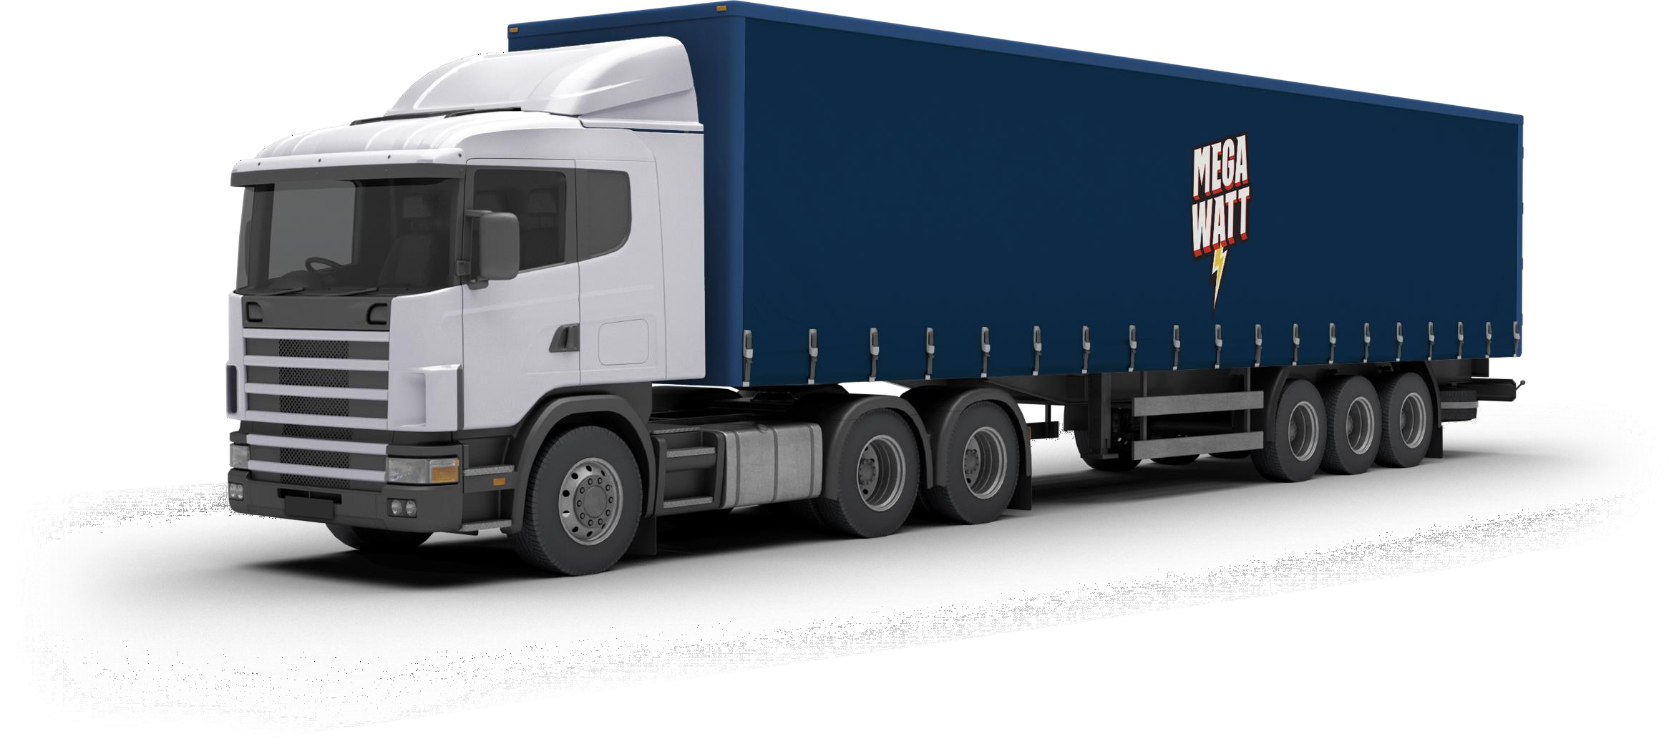
Logistics Data
1 Tray
24 Cans
1 Pallet
120 Trays
1 Truck
info@mega-watt.eu
+49 160 3042400 • www.mega-watt.eu
29 Pallets /83520Cans
Mega Watt Europe GmbH • Marburgerstr. 27b • 35745 Herborn-Seelbach • Germany
Notes:
Source: Mega Watt official website, https://www.mega-watt.eu/ (accessed 12 September 2026).

Slide 15
WINGS? JUST A DREAM …
WAKE UP TO A MILLION WATTS
MEGA WATT — DREAMS OFF POWER ON
Notes:
Source: Mega Watt official website, https://www.mega-watt.eu/ (accessed 12 September 2026). Cover visual supplied by Mega Watt Europe GmbH.

Slide 16

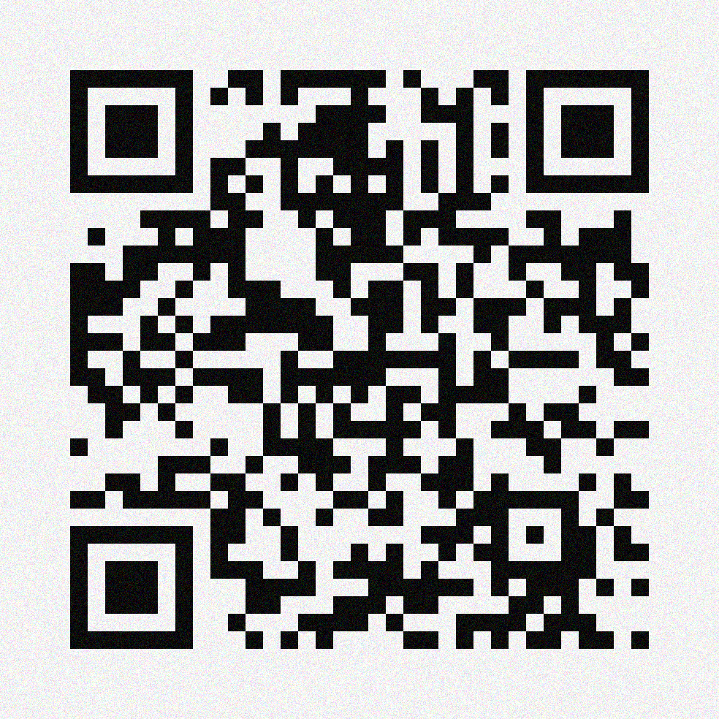
WORK WITH US
Turn one million watts into one million opportunities
Mega Watt — power your market
Become a Distributor
www.Mega-Watt.eu
export@Mega-Watt.eu
+49 160 3042400
Mega Watt Europe GmbH • Marburgerstr. 27b • 35745 Herborn-Seelbach • Germany
Notes:
Source: Mega Watt official website, https://www.mega-watt.eu/ (accessed 12 September 2026).

